Slide 1
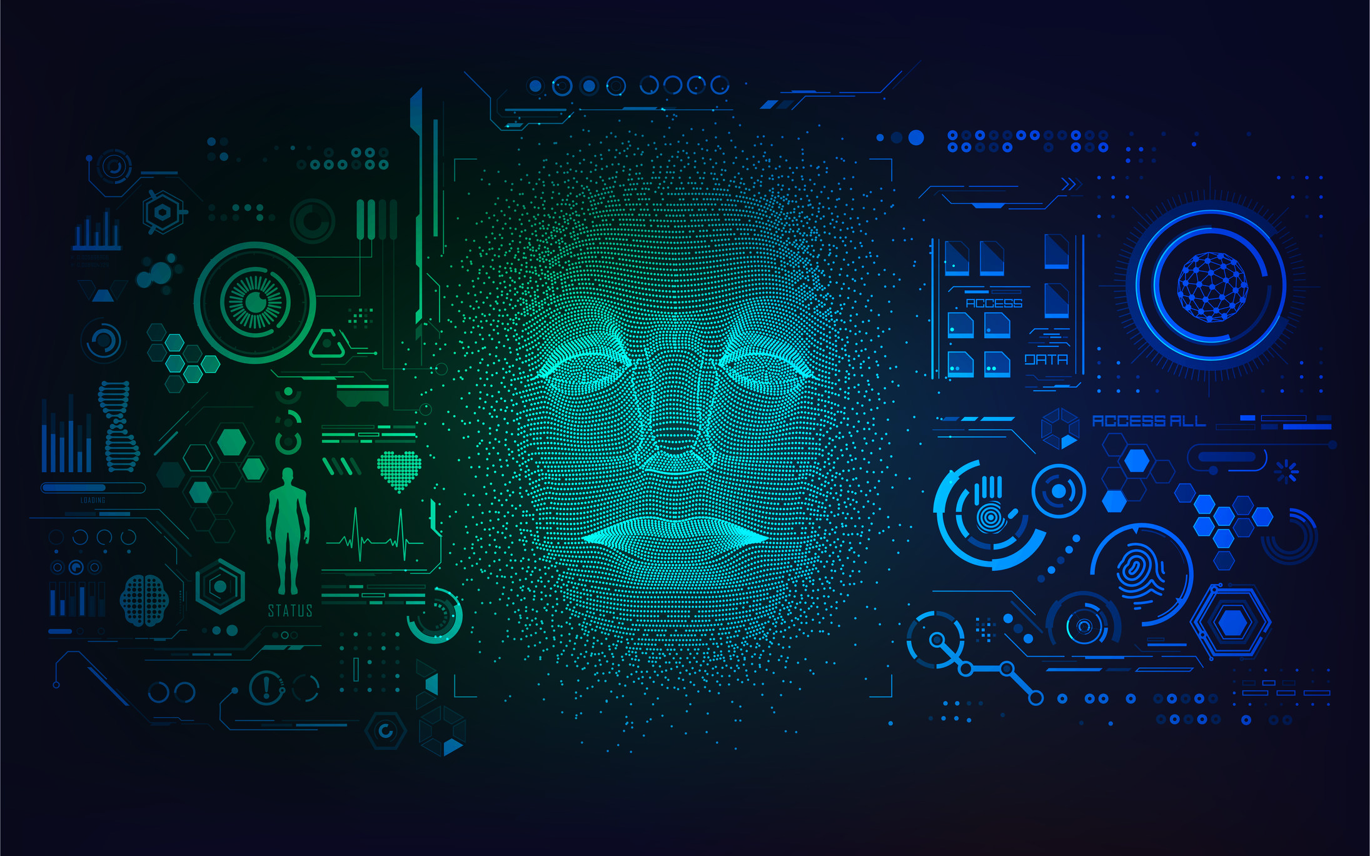
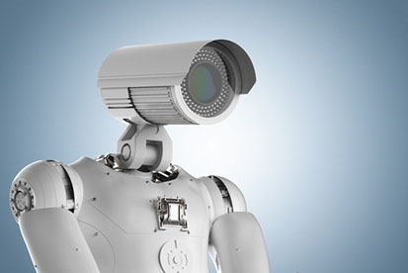
Deep Surveillance Using Deep Learning & A.I
To detect & REPORT Suspicious activities of people around

Slide 2
Quick introduction about myself
A Data Science enthusiast advancing in the field of ML, Deep learning and A.I
My Name : Mohit .Chvk
Pursuing: 2nd Year, Computer Science Engineering (B.S)
at Chandigarh University, INDIA

Slide 3
Currently….
2.5 Million robberies take place in U.S alone per year
Around 0.5 million crimes take place every year in the world
60-70% of these cases remain unsolved every year

Slide 4
Benefits of deep surveillance using A.I Cams
Alerting cops or personal security by…
Part 1:
Increasing the security for women and children in public areas
Making offices more secured from intruders
Security surveillance at stores
Securing home by identifying the visitors
Part 2:
Detecting suspicious and most wanted criminals wandering around in airports/ public areas
Surveillance of Militant Activities at the Country Borders

Slide 5
TOOLS USED to build deep surveillance system
A Deep Learning Model Trained on my own by using 35,887 data set of images to predict the suspicious activities.
A Cam to check on the people around.
TECHNICAL Knowhow and knowledge required to build algorithms using…,
Deep Learning / Machine Learning
Python
CNN Algorithm
Tensorflow
Keras
Open CV

Slide 6
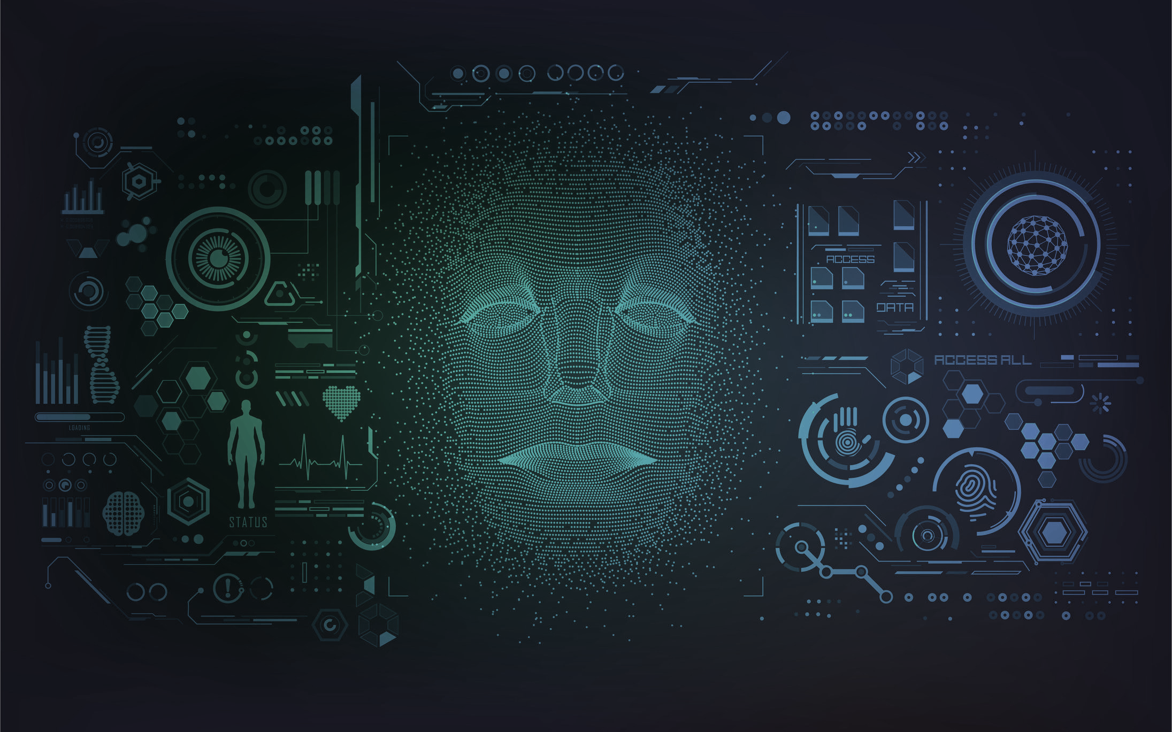
THANK YOU
Mohit . CHVK
Email : Mohit.Chvk@Gmail.com
Linked in : http://www.linkedin.com/in/mohit9999

